Slide 1
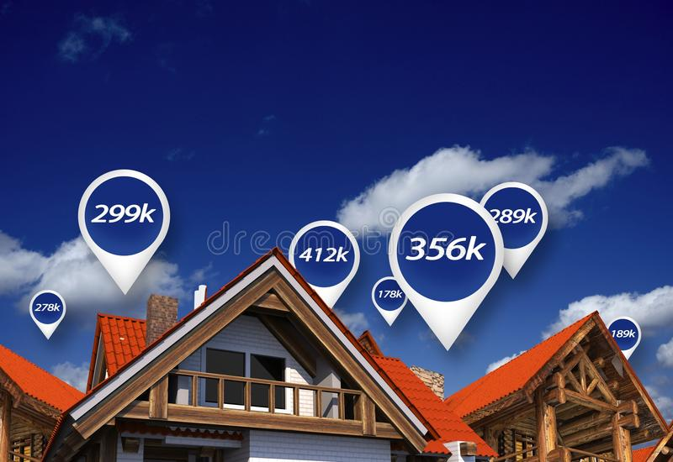
Analysis of factors that drive house prices

Slide 2
Overview
The bank is interested in investing in mortgage-backed securities
A research and analysis has been performed to evaluate some factors that drive price of houses.
Variables focused on the analysis are year built and number of bedrooms

Slide 3
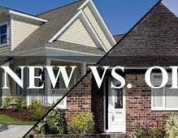
Do these two factors make house prices higher?
Are the prices of new houses higher than old houses? New houses are those built in and after 1971 and old houses are those built before 1971
Are 3 bedrooms houses more expensive than houses with 2 bedrooms?
How much on average is the difference in house prices?

Slide 4
Data Analyzed
Approximately 1,400 houses built between 1872 and 2010
Data includes year built, number of bedrooms and sale prices
Raw data can be found in this link: house prices

Slide 5
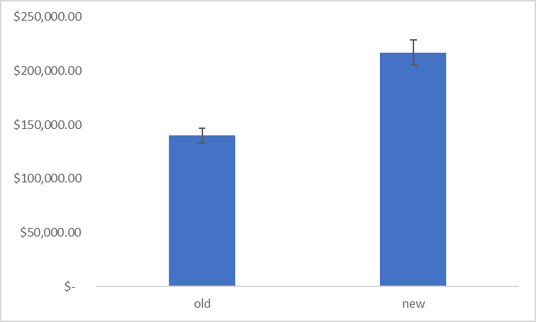
Old houses VS Newer houses prices
Statistically difference between old and new houses
With a 95% confidence level, newer homes built after 1970 will be between $70,000 and $84,000 more expensive than older homes
Notes:
Houses built before 1971, cost $77,000 less than a house built in or after 1971. Over the 1,400 houses, the average price of old houses was $140,000. However, the average price of newer houses was $217,000

Slide 6
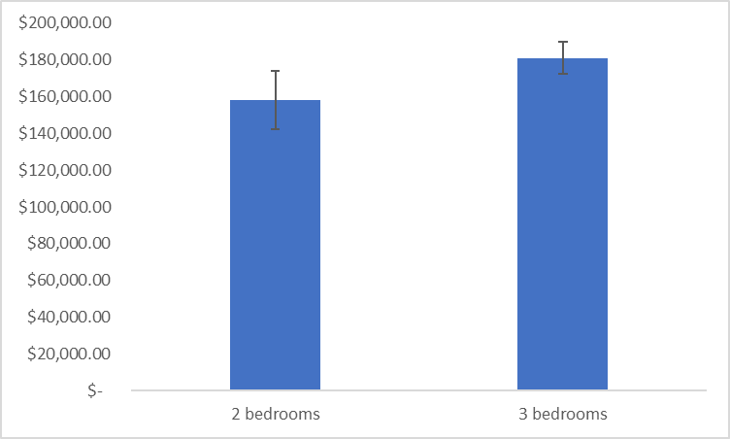
2 Bedrooms VS 3 Bedrooms houses prices
Statistically difference between 2- and 3-bedrooms houses
With a 95% confidence level, homes of 3 bedrooms will be between $13,000 and $32,000 more expensive than homes of 2 bedrooms
Notes:
Regardless of the year, 2-bedroom houses cost $22,000 less than a 3-bedroom house. Over the 1,400 houses, the average price of a 2-bedroom house was $158,000. However, the average price of a 3-bedroom house was $181,000

Slide 7
Recommendations
House prices might increase
Invest in mortgages of houses with similar profiles
Buy 3 bedrooms houses built after 1970
Next steps: Perform an analysis of locations by zip code

Slide 8

ANY QUESTIONS?

